Slide 1


Slide 2
CWAHEC Staff
Nancy Spurgeon – Director nspurgeon@wvc.edu
Jordan Johnson – Coordinator jjohnson2@wvc.edu
Kristen Hosey – AHEC Scholars Instructor khosey@wvc.edu

Slide 3
Area Health Education Center
Is a national program developed by Congress in 1971 to recruit, train and retain a health professions workforce commitment to underserved populations.
The purpose of the AHEC Program is to develop and enhance education and training networks within communities, academic institutions, and community-based organizations.

Slide 4
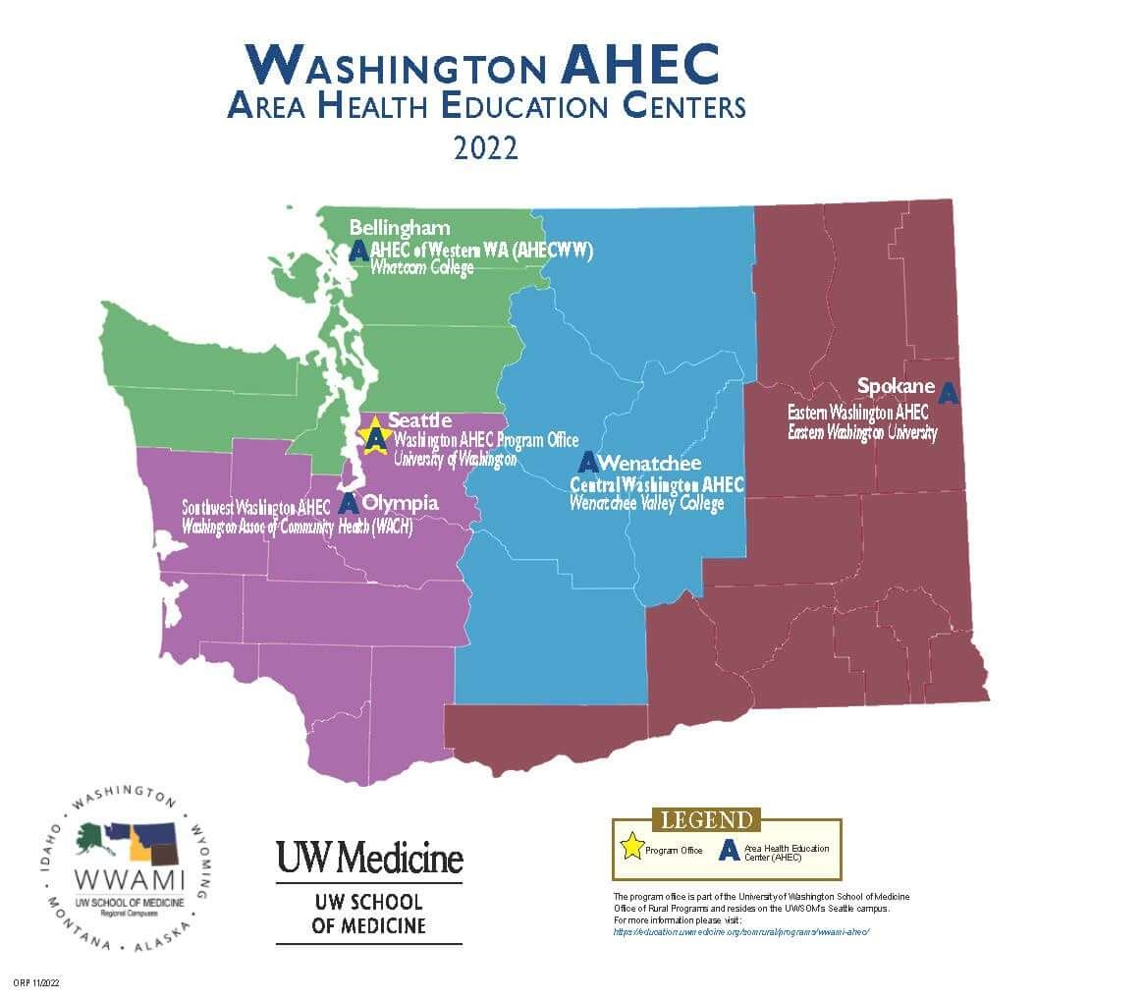
Central Washington AHEC serves six counties:
Chelan
Douglas
Grant
Okanogan
Kittitas
Yakima

Slide 5

Strategic Priorities:
Increase diversity among health professionals
01
Broaden the distribution of the health workforce
02
Enhance health care quality
03
Improve health care delivery to rural and underserved areas and populations
04

Slide 6

Three Components of the AHEC Program
AHEC Scholars Program
Professional Development
Health Care Career Pipeline

Slide 7

AHEC Scholars
Do you want to lead healthcare into the future?
AHEC Scholars exposes students to interprofessional clinical & community-based learning in rural & underserved communities.
“A strong, flexible, and collaborative health workforce is one of the best ways to confront the highly complex health challenges facing communities around the world.” ~WHO

Slide 8
AHEC Scholars
Rural and urban underserved communities require healthcare workers who are well-prepared for team-based care and reflect the communities they serve.
To address this dire need, HRSA offers AHEC Scholars, a free 2-year interprofessional certificate program available to students in an HRSA-qualified health professions degree program or an allied health workforce degree program of at least 2 years.

Slide 9
Program Overview
Two year program
Each year, students complete 40 hours of online training and another 40 hours of community/experiential/clinical based learning out in the field.
Many students complete their community-based learning in a small rural community, but there is also an option for working with urban underserved populations.
Students may be able to double-count some academic coursework to meet AHEC Scholars requirements. For example, students who do clinical rotations may count their clinical hours towards the 40 hours of community, experiential, and clinical learning.

Slide 10

Curriculum Core Topic Areas
Interprofessional Education
Behavioral Health Integration
Social Determinants of Health
Practice Transformation
Cultural Humility
Telehealth
Connecting Communities & Supporting Health Professionals
Interprofessional Education

Slide 11
Central Washington AHEC Schedule
Year 1
January 17, 2024: AHEC Scholars Kickoff Event
January 22, 2024: First day of year 1 classes, starting at 6:30 PM
Spring/Summer 2024: Year 1 40-hour community experience
Year 2
Fall 2024 TBD: First day of year 2 classes
Winter 2025: Year 2 40-hour community experience
May 2025 TBD: Graduation
Year 3
One year follow-up

Slide 12

Benefits of the Program
Free!
HRSA Branded Certificate to add to CV
University of Washington School of Medicine Curriculum
Washington AHEC Alumni Group
Professional Development Opportunities
AHEC Support Team

Slide 13
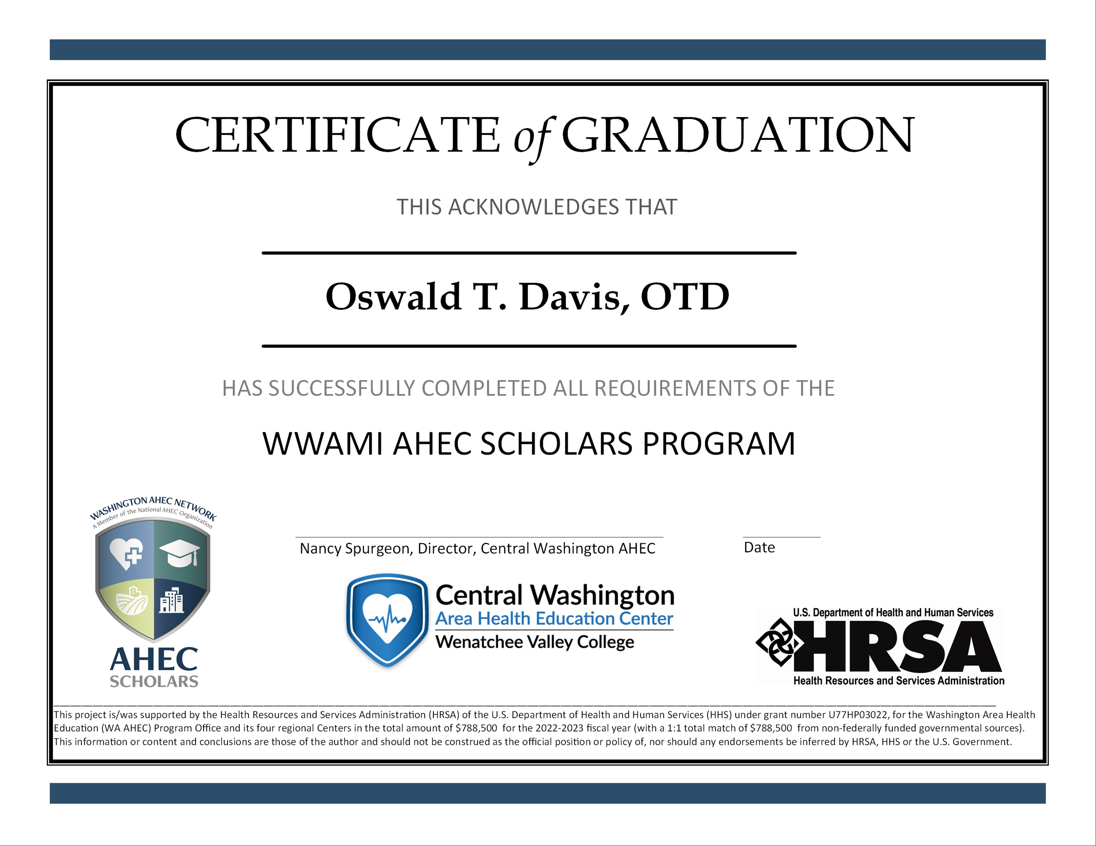

Slide 14

Application
https://tinyurl.com/cwahecscholars

Slide 15
Questions?
Jordan Johnson – AHEC Coordinator
509-682-6595
jjohnson2@wvc.edu
Nancy Spurgeon – AHEC Director
509-682-6991
nspurgeon@wvc.edu
Kristen Hosey – AHEC Scholars Instructor
khosey@wvc.edu

